Slide 1
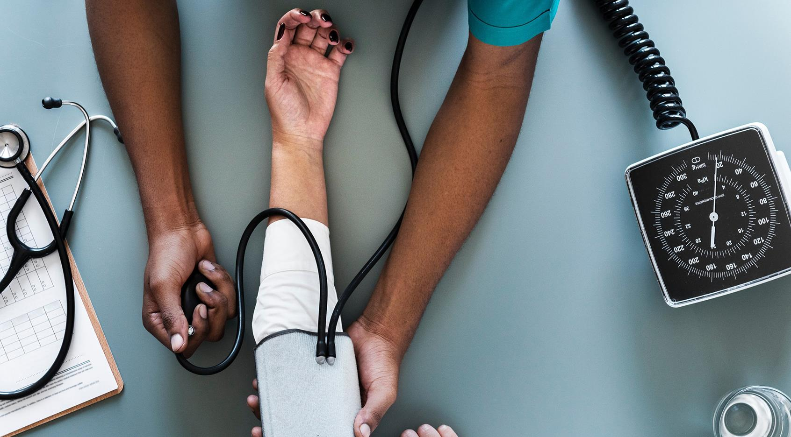
Digitalized Business Processes for Family Doctors
Burrata Health Solutions
Automated appointments, consultations and prescriptions

Slide 2
Agenda
1
2
3
4
About Us
The Use Case
Challenges
Our Solution

Slide 3
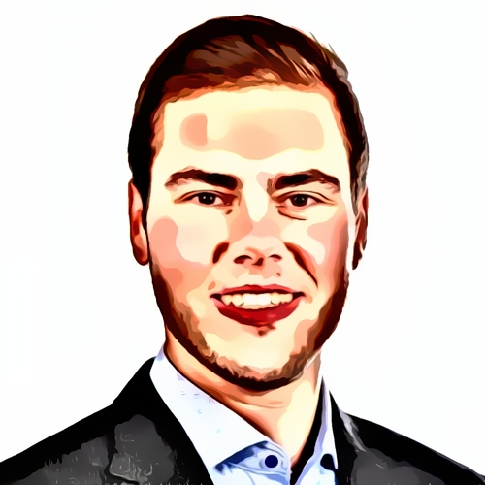
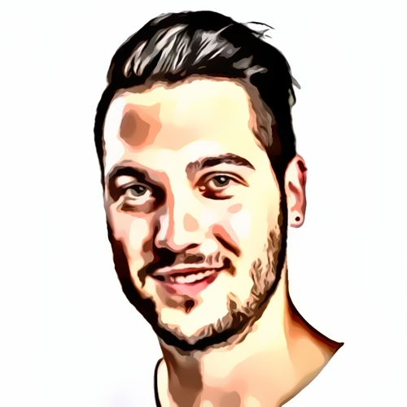
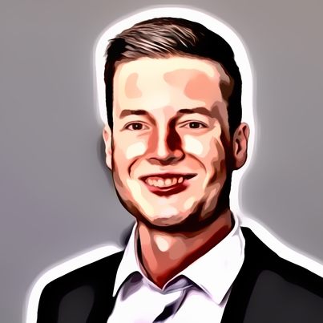
About us
Martin Schmitz
Kevin Saner
Lars Moser
Head of Software Engineering
Head of Technology
Head of Sales

Slide 4

The Use Case: Appointment with family doctor
Patient needs a (follow-up) consultation
Schedules appointment on phone with medical assistant
Patient travels back home
Patient travels to doctor’s office
Prescription for patient is issued
Patient is registered
Consultation takes place

Slide 5




Challenges
High amount of manual tasks
Long and inconvenient travel times for patients
Many steps incl. documentation are still paper-based
Inefficient processes result in high health costs

Slide 6

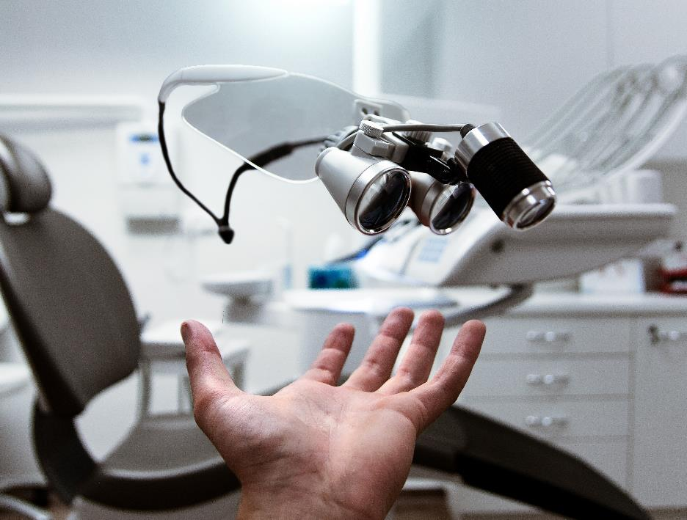
Is there a solution to tackle those challenges?

Slide 7
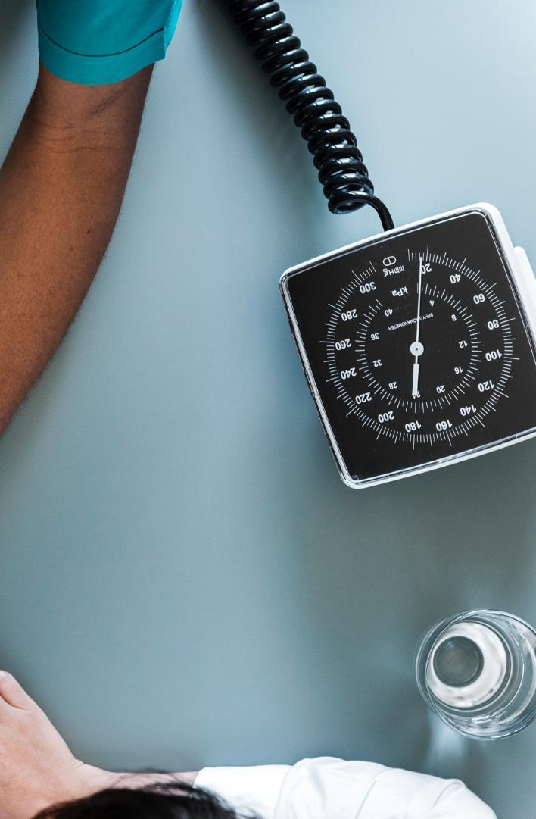



Medical Chatbot
Remote prescription module
Automated diagnosis
Fully digitalized scheduling process
Product features

Slide 8

How does it work?

Slide 9

Appointment Scheduling
Benefits
No human interaction from the doctor’s office is necessary
No unintentional date overlaps
E-mail confirmation for patient

Slide 10

Make a Diagnosis
Benefits
Patient no longer must visit a doctor's office in person
Patients are less emotionally stressed as there is no travelling involved
Doctors have more time for patients who need a physical appointment
Lower costs on patient and doctor side
Patient's answers to medical questions and the medical advice given by the chatbot are automatically documented in the patient file

Slide 11
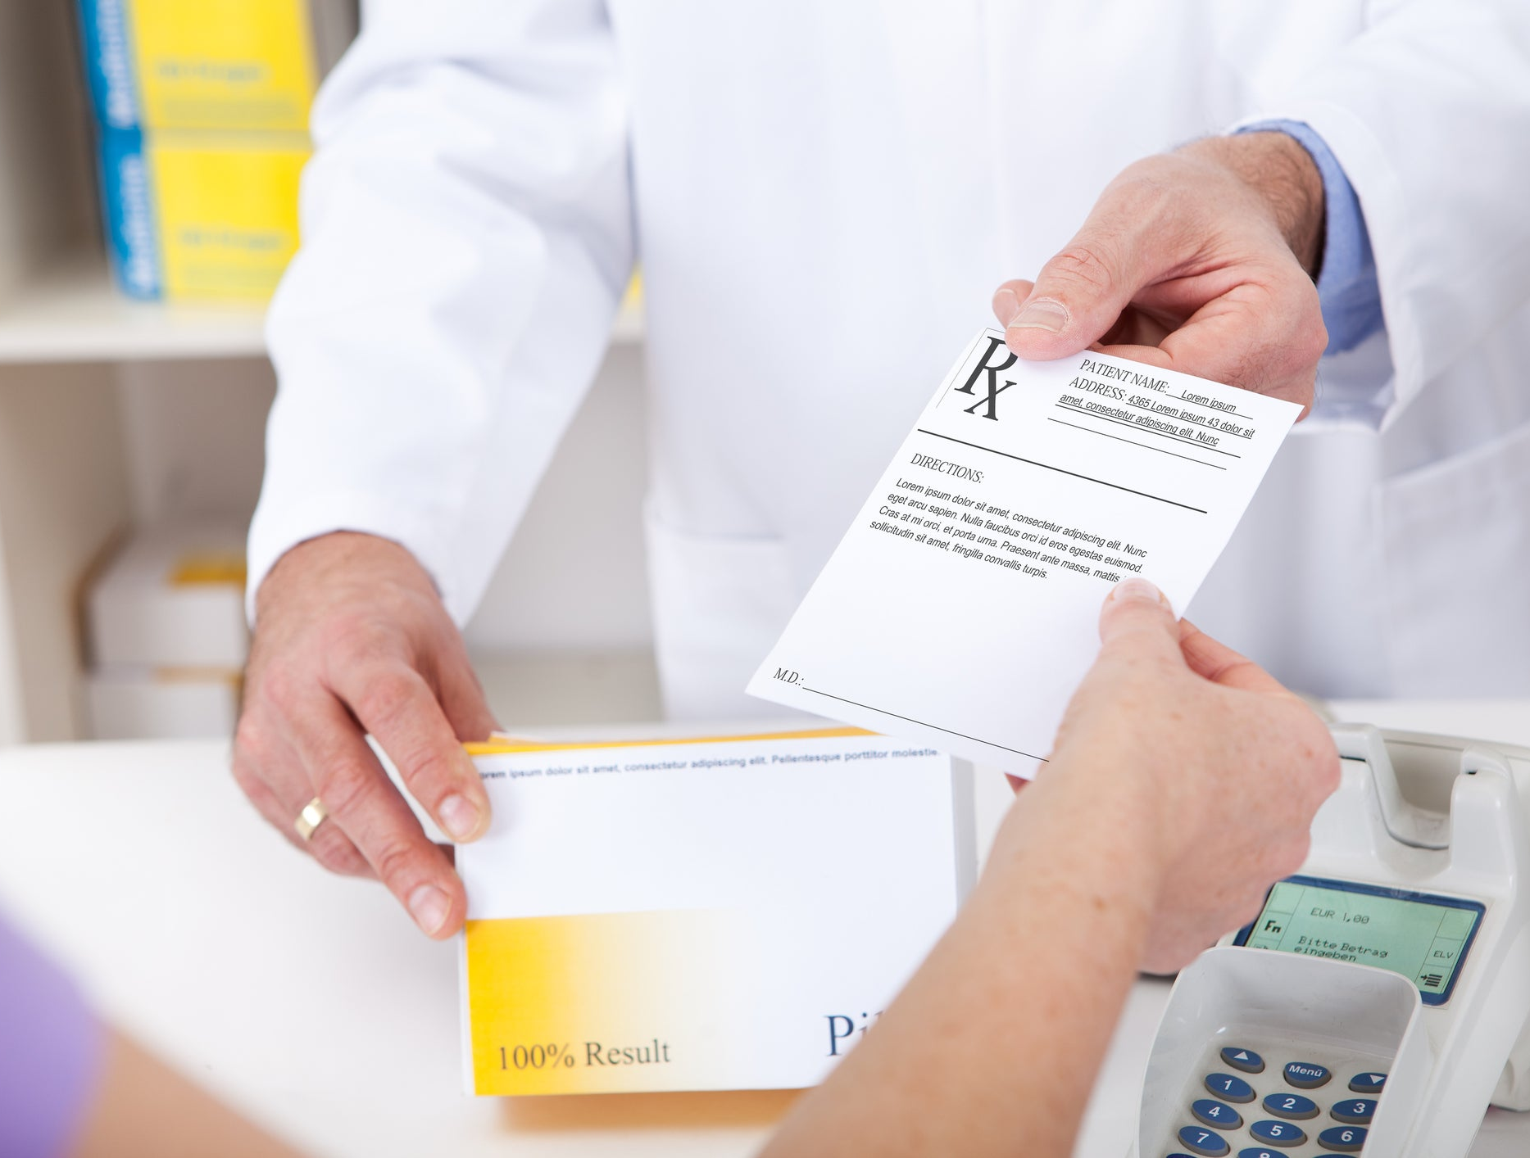
Issue prescription
Benefits
Less administrative work for medical assistants and doctor
Prescriptions are still checked by a doctor
Patient automatically receives prescription via email

Slide 12
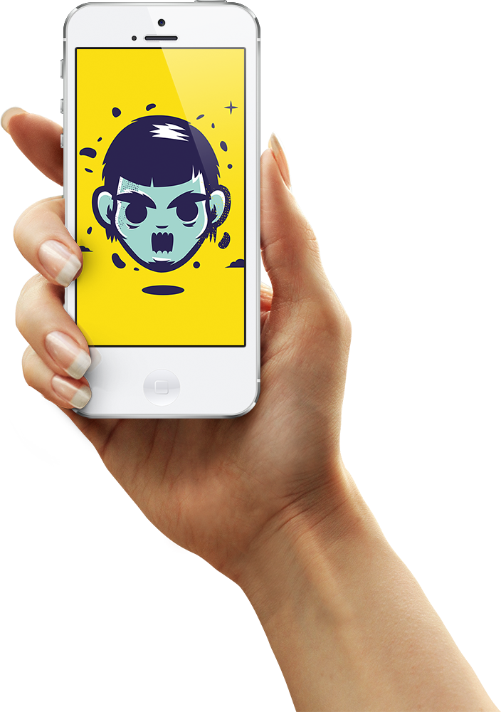
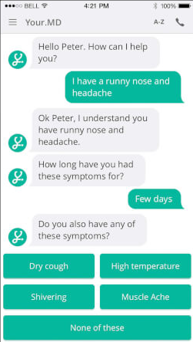




Medical Chatbot
Easy way to make appointments
Automatic diagnosis based on symptom checker
Issue prescriptions remotely
More time for patients
Less paperwork
Cost reduction
Happier patients

Slide 13




Thank you for your attention
Lars Moser, Head of Sales
+41 32 452 33 55
lars.moser@burratahs.com
www.burratahs.com

